Slide 1
High sensitivity pathologised: A point in case!
Prof. dr. Anna M.T. Bosman
Radboud University Nijmegen
Department of Special Education
The Netherlands
Consciousness in Crisis, Leiden
September 15th, 2012

Slide 2
Preamble of WHO (1998)
“Health is a dynamic state of (complete) physical, mental, spiritual and social well-being and not merely the absence of disease and infirmity.”

Slide 3
Spiritual crisis
A psychological transformation, which reveals itself by extra-ordinary experiences such as:
Changing states of consciousness
Visions/apparations (visioenen)
Paranormal experiences
Energetic disturbances
Unusual physical experiences

Slide 4
(High) Sensitivity
Sensitivity derives from the Latin Sensus; via the French Sens, it became Sense
Original meaning: find your way
1400: ability to perceive, interpretation, feelings
1526: referring to external sense organs
1816: referring to extreme physical experiences
1900: overly sensitive

Slide 5
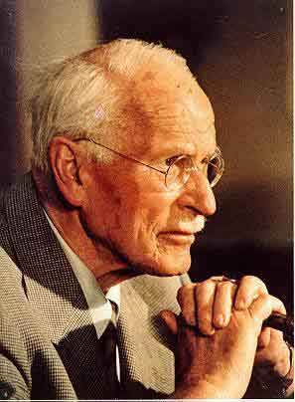
Sensitivity
Carl Jung (1875-1961)
1913-1914
inherited trait not caused by trauma,
but may cause neurosis
1921
introvert is a person who directs psychic
energy inward, away from objects, as
if they are experienced as too powerful

Slide 6
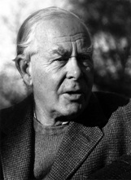
Sensitive environment
John Bowlby(1907-1990)
Founder of the attachment theory
Psychoanalyst and Ethologist
1950
WHO asks Bowlby for advice on the
mental health of homeless children
Raising a child to a healthy person requires a sensitive caretaker

Slide 7
High Sensitivity
Scientific term: ‘Sensory processing sensitivity’
refers to a relatively sensitive nervous system
aware of subtleties in the environment:
bodily (physical)
emotional (empathy)
cognitive (understanding)
more easily overwhelmed
Dr. Elaine N. Aron

Slide 8
Research on High Sensitivity reveals
Adults
HS is not shyness, introversion, or neuroticism
Valued in the East, problem or even disorder in the West
Children
Number of HS _{boys} < Number of HS _{girls}
High Sensitive Child (HSC) is more likely to have internalising problems
HSC has no more chance of exhibiting externalising problems
HSC is not related to learning problems
Self-ratings differ dramatically from other-ratings
Animals
different 'personalities' in a variety of species: great tit, fruit flies, primates, fish etc….

Slide 9
(High) Sensitivity: what makes it interesting?
It is present in all living (and non-living?) things
It appears to be based on a biological property
It reveals a crisis in Psychological Science
It exemplifies a crisis in the Empirical Sciences

Slide 10
The crisis in Psychological Science 1

Slide 11
The crisis in Psychological Science 2

Slide 12
The crisis in Psychological Science 3

Slide 13
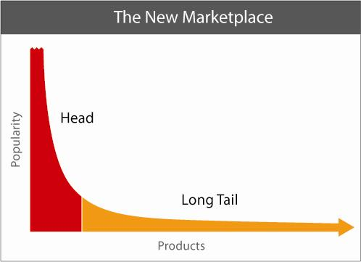
The crisis in Psychological Science 4
or any other continuous distribution, such as a Power law (e.g., Pareto’s law)

Slide 14
The crisis in Empirical Science
X₁ = Τ + ε₁; X₂ = Τ + ε₂; X₃ = Τ + ε₃; X₄ = Τ + ε₄; X₅ = Τ + ε₅ etc….

Slide 15
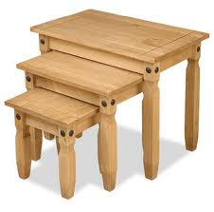
So far, so good.........

Slide 16
Adophe Quetelet (1797-1874)
’The larger the number of individuals that one observes, the more the individual specifics, it being either physical or moral (psychological), are being erased and the more they determine the general facts that by virtue of which society exists and maintains itself’ (1835).
The average individual may be compared with the centre of gravity of a body.
If you shoot at a bird once from the left and once from the right, on average the bird will be dead.

Slide 17
So far, not so good......
Typical length of humans in a country
Typical opinion of men about sex
Typical response of mice in a maze
Typical morals of a people
Typical High Sensitive Person vs. Typical non-HSP

Slide 18
There is hope, however,……..
A manifesto on psychology as idiographic science: Bringing the person back into scientific psychology, this time forever.
by: Peter C.M. Molenaar
in: Measurement, 2, 201-218, 2004.

Slide 19
Thank you for your attention www.annabosman.eu

